Slide 1
Blockchain Enabled E-Voting
A secure and tamperproof voting system
Nandakishore VV TVE16MCA33

Slide 2
Problems of existing Systems Paper Ballot, E- Voting Machines
Ballot papers are difficult to prepare on time, handle, count and preserve.
Votes casted can be invalid, or can be registered wrong if handled incorrectly
Electronic voting machines can be easily tampered with by the officials
Fraudulent machines can be employed by dishonest officials
Software bugs can lead to the votes being saved improperly

Slide 3
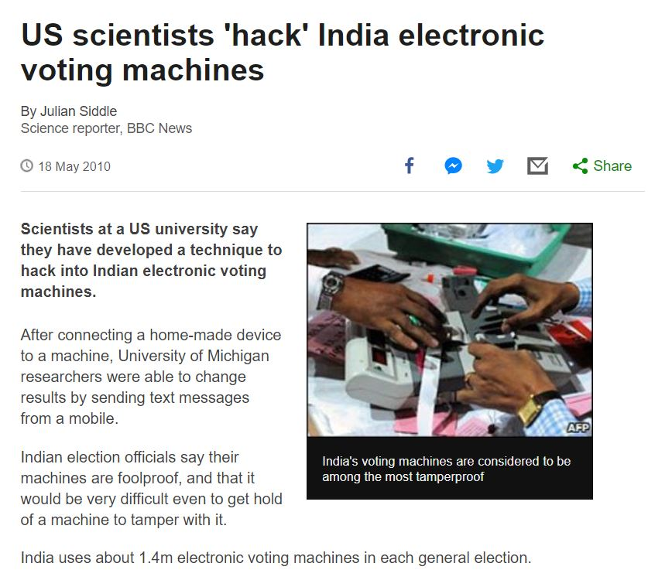
Tampering with EVMs have happened and it still makes news during election time

Slide 4
Proposed System Blockchain Enabled E-Voting Goals
Develop a voting mechanism which is secure and can’t be corrupted
A system should be developed which eliminates fraudulent voters
A system which is cost efficient and secure at the same time
Increase the voter participation in elections
Reduce election time violence caused due to fraudulent votes and voters

Slide 5
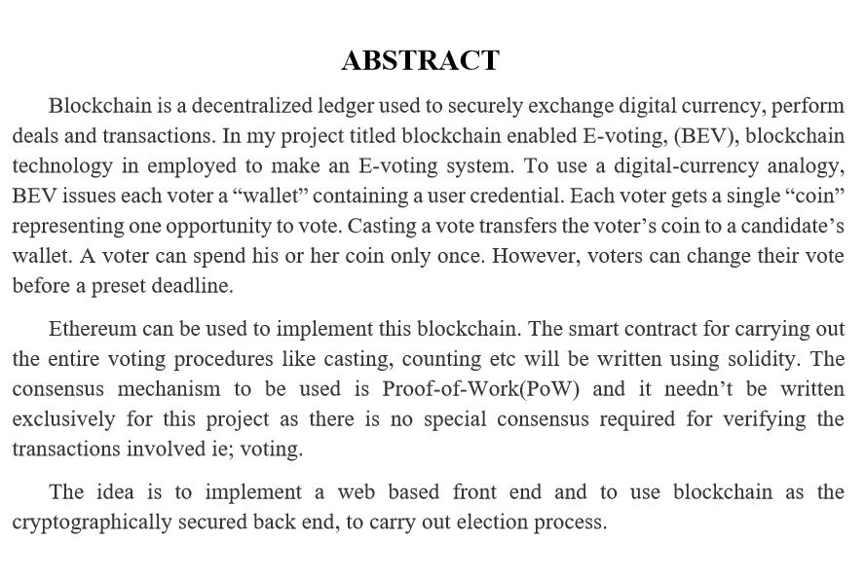

Slide 6
Methodology Blockchain
Blockchain can be used to implement voting procedures
An interface will be provided to the voters and they can log-in using a unique ID
Votes are considered as transactions and are validated and added to the chain
A voter is given a coin during one election time and he/she can cast a vote only using this coin
One vote – One coin
Prevents double spending because a user cannot cast a vote without a coin
Ethereum can be used to implement the voting blockchain

Slide 7
B e-V Challenges
Gain confidence from the governments and electoral bodies as this is a new technology
Adapting to a different style of voting system from the traditional ones
Ethereum is immature and improving, hence the quality of code cannot be ensured to be 100%
Gaining trust from the general masses as the technology is totally different from the traditional client-server based systems

Slide 8
Thank You

